Slide 1




Right UNITS
Right HOURS Right WORK
David Gormley
Assistant Director Professional Services
Matt Sipes
Branch Manager Developmental Branch

Slide 2


Why We’re Here
Budgets are tighter than they've been in years.
Everyone is feeling the pressure:
  KYTC trying to deliver more with less.
  Consultants being asked to do more while protecting profitability.
Proposed hours are getting further and further apart
The goal isn't to reduce fees.
The goal is to develop realistic scopes that match the work.

Slide 3

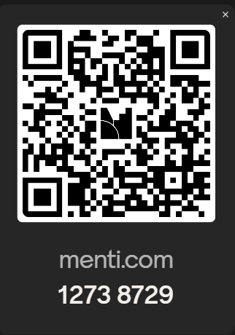
Agenda
Get your input!
Evolution of Production Hours
Common Issues
Walk through / Talk through Updated to the Production Hours

Slide 4

The Evolution of Production Hours
"Back when they were Manhours..."
Updated in 2013
David assumed negotiations in 2016
Greater PM involvement
Updated to incorporate ORD in 2023
Why PM ownership matters

Slide 5


Right Units / Right Hours / Right Work
Budgets Matter
  More now than ever!
  A $1.2 million dollar fee on a $800k project is either a hours issue or a scoping issue.

Slide 6
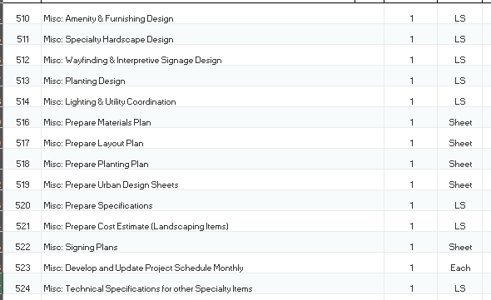
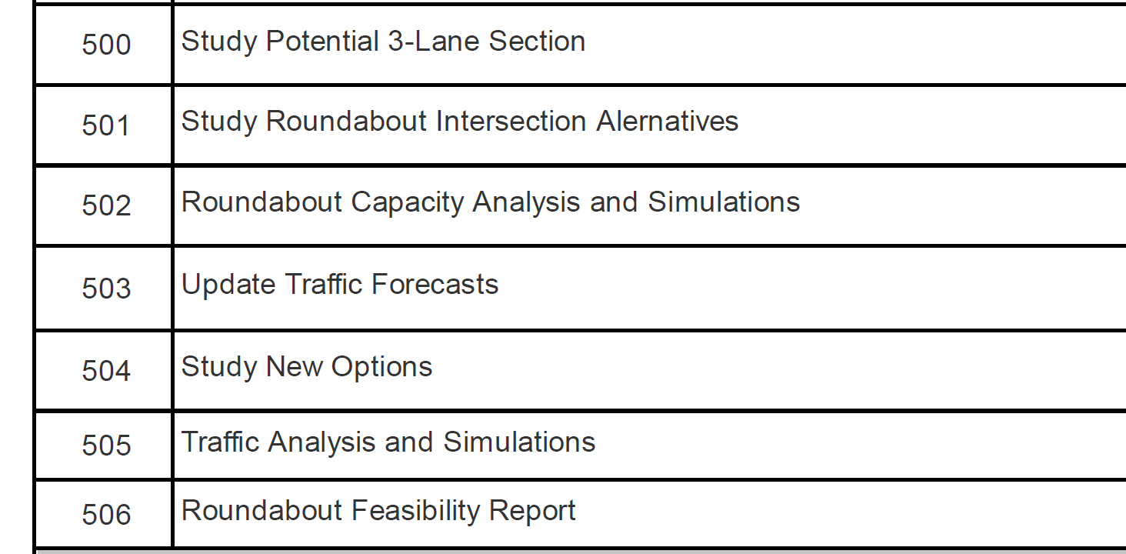
Right Units / Right Hours / Right Work
Some issues we’ve seen that inflate fee
  Adding Excessive Misc items

Slide 7
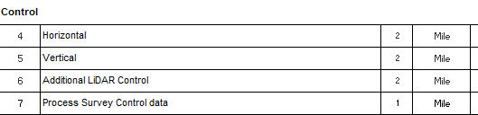
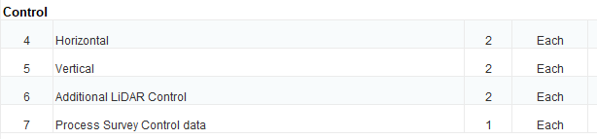
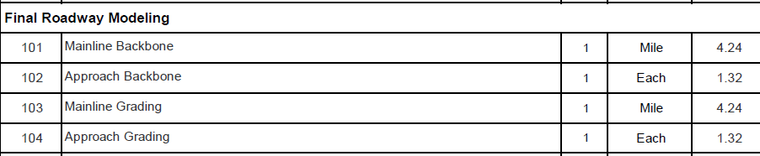
Right Units / Right Hours / Right Work
Some issues we’ve seen that inflate fee
  Adding Excessive Misc items
  Changing Units / Using Wrong Units

Slide 8
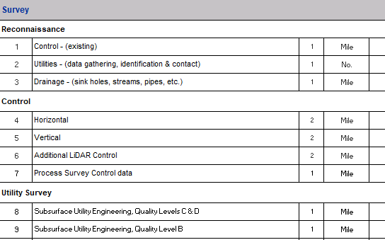
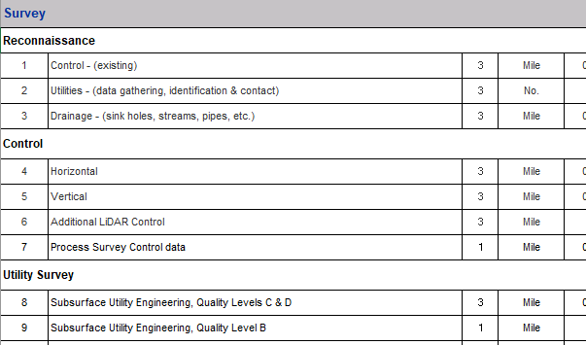
Right Units / Right Hours / Right Work
Some issues we’ve seen that inflate fee
  Adding Excessive Misc items
  Changing Units
  Inflating Crews

Slide 9
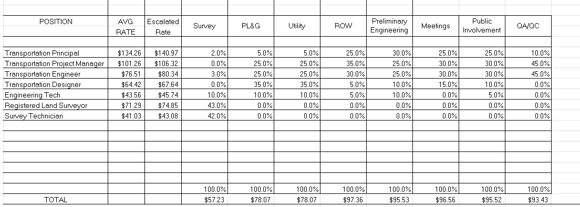
Right Units / Right Hours / Right Work
Some issues we’ve seen that inflate fee
  Adding Excessive Misc items
  Changing Units
  Inflating Crews
  Wonky Classifications and Percentages

Slide 10
Right Units / Right Hours / Right Work
Budgets Matter
  More now than ever!
Scope is Critical

Slide 11

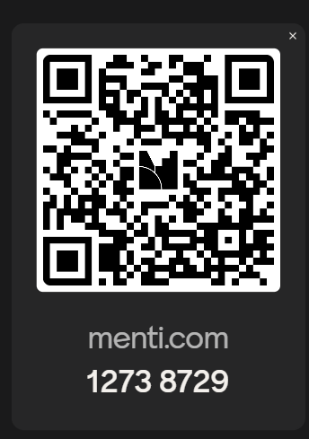


What Do We Do About It?
We talk about it.
To anyone that will listen:
  District Listening Sessions – 2025
  ACEC involvement
  Design Subcommittee

Slide 12






What We Heard
Confusion
Frustration
Acceptance - “how it’s always done”

Slide 13
What Are We Gonna Do?
Worksheet needs to be updated!
Let’s walk through the Worksheet
Highlight proposed changes
Open discussion - Any comments or requests?

Slide 14
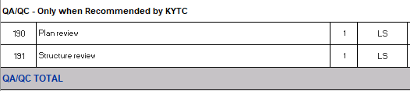
Notes:
Downstream users have see more problems.. Qty
Paying for QA/QC – Some people on board. We think there will be some sort of deliverable.
Consultant job is to deliver a quality set of project. Consultants can black ball yourself or your company..
Done
83 people in HD from old building to new one. Use to look at
Now 30 people.

Slide 15
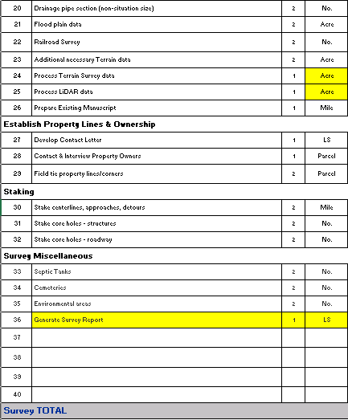
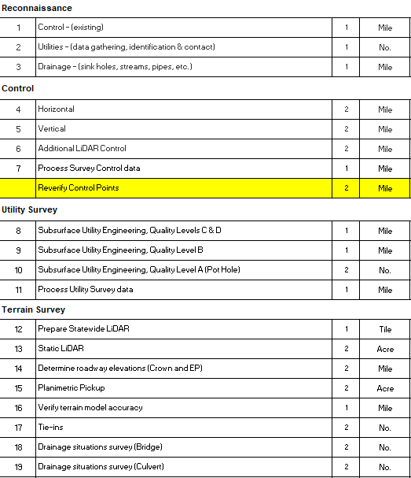

Slide 16
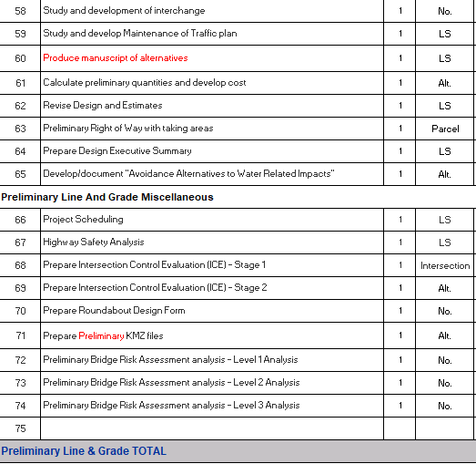
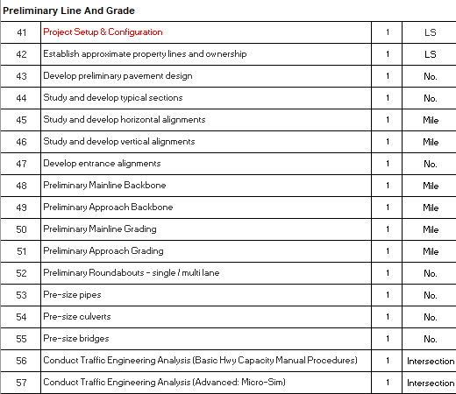

Slide 17
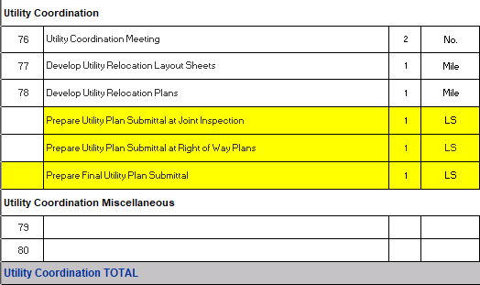

Slide 18
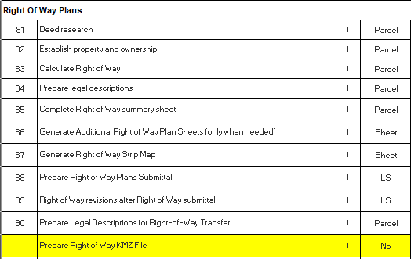
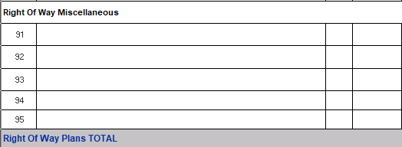

Slide 19
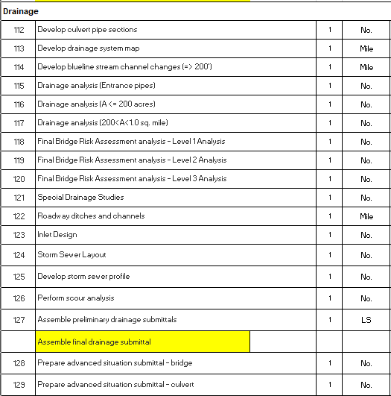
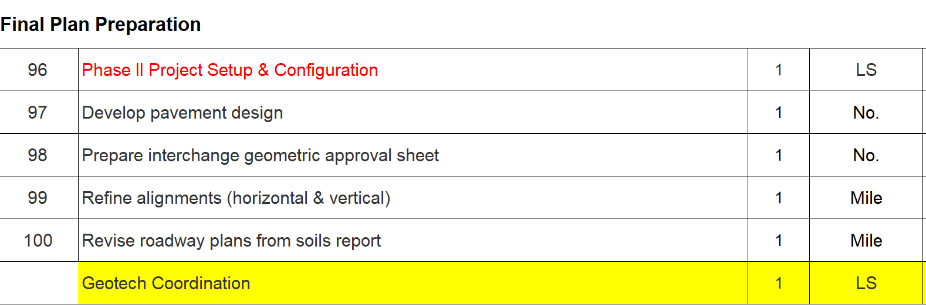
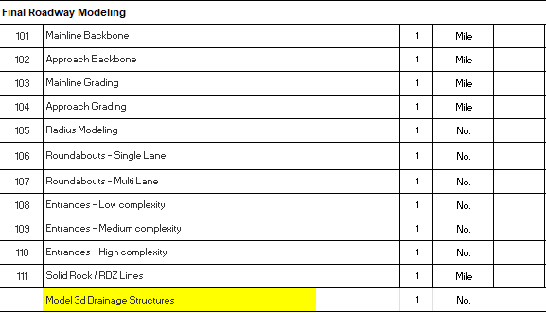

Slide 20
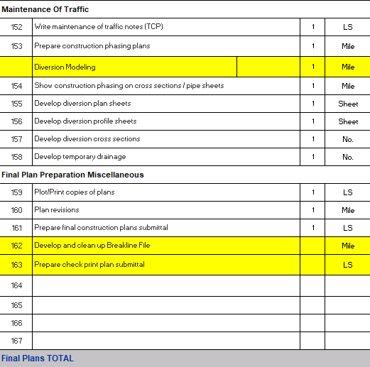
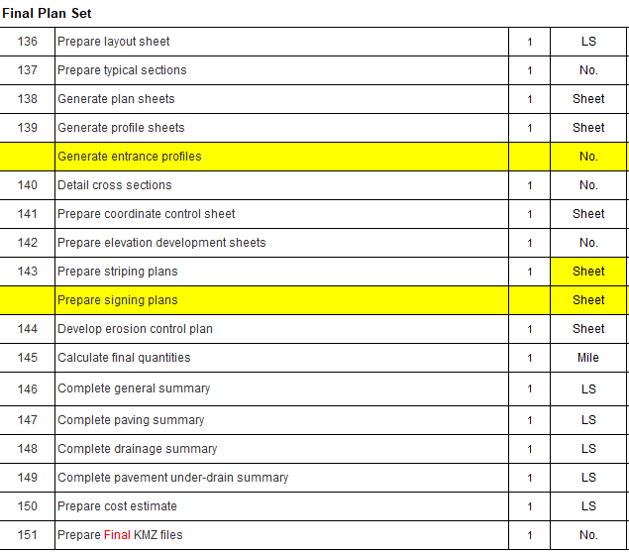

Slide 21
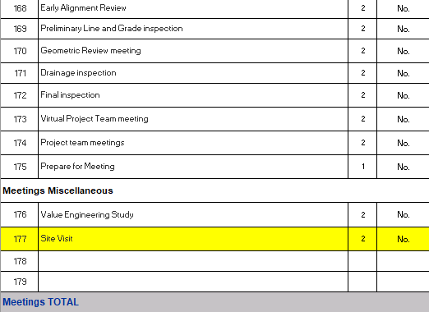

Slide 22
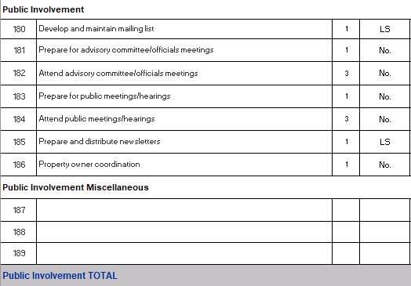

Slide 23
Right Units / Right Hours / Right Work = Better Projects
Spreadsheets need to change
PMs need support
Get the Units right and the Hours will follow.
The goal is to develop realistic scopes that match the work.

Slide 24
QUESTIONS
David Gormley
Assistant Director Professional Services
David.Gormley@ky.gov
Matt Sipes
Branch Manager Developmental Branch
matthew.sipes@ky.gov

